Slide 1


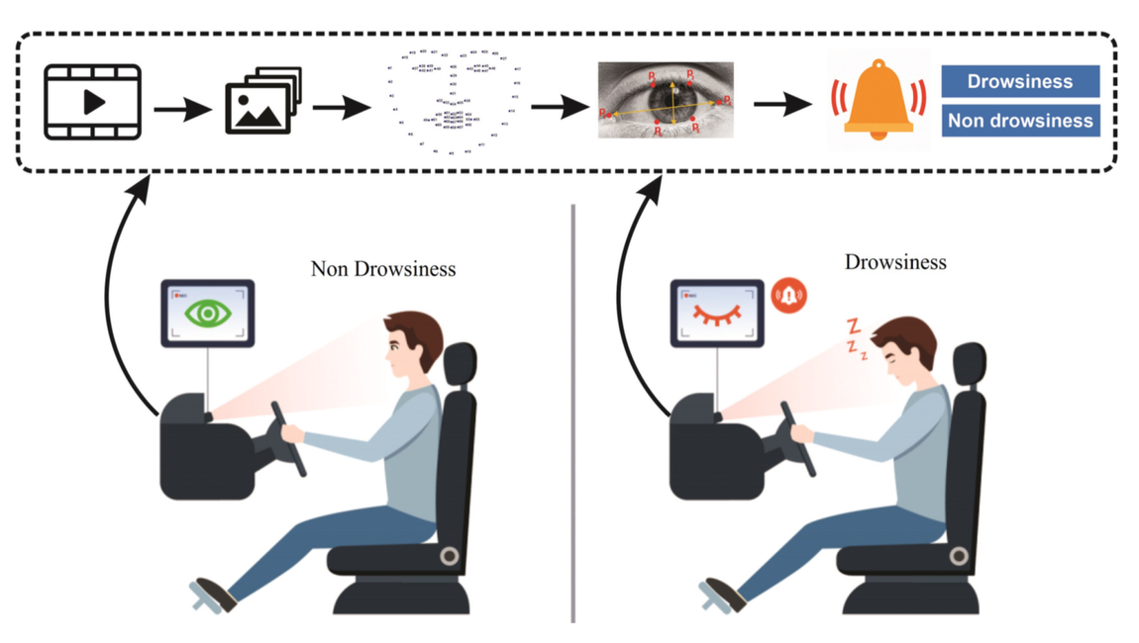
IEEE HACK2.0
DRIVER DROWSINESS DETECTION USING COMPUTER VISION TECHNIQUES
DOMAIN:COMPUTER VISION
TEAM NAME : TEAM ZEEZ
TEAM LEADER: ROHINI B
TEAM MEMBERS:VARUN RAAJ SM,VASANTHA RUBAN,SHIVA RAMALINGAM V
COLLEGE:CHENNAI INSTITUTE OF TECHNOLOGY,CHENNAI

Slide 2
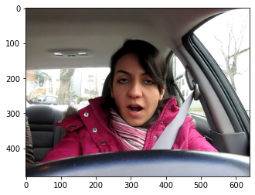
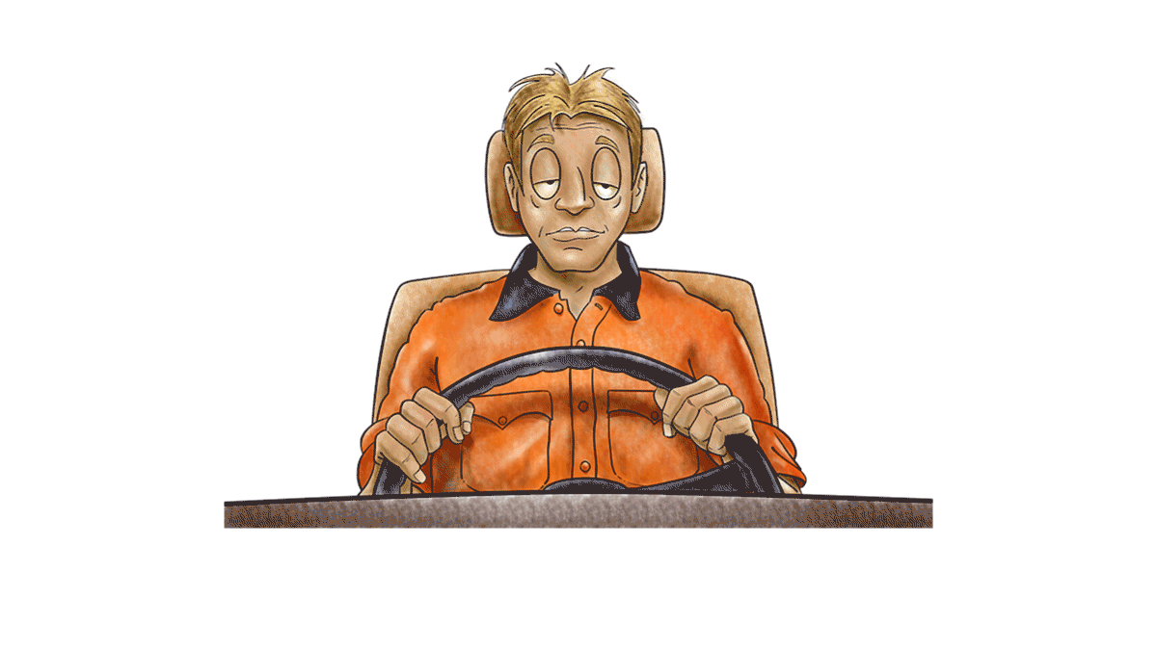
PROBLEM STATEMENT
Develop a Machine Learning/Deep Learning algorithm designed to analyze video feeds from an in-car camera. The primary objective is to accurately detect occurrences of driver drowsiness, unease, or sleepiness. The ultimate aim is to produce a comprehensive prototype that can be seamlessly integrated into vehicles, thereby contributing to the improvement of road safety.

Slide 3
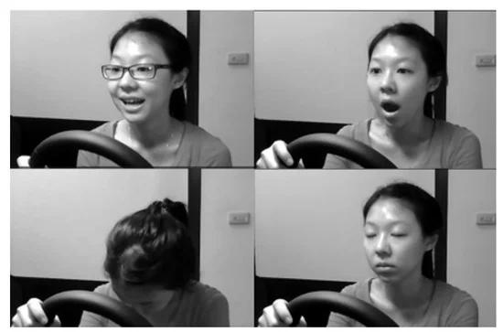
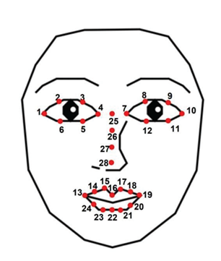
IDEA OVERVIEW
The proposed solution aims to develop a real-time drowsiness detection system using Python, dlib, and OpenCV.
The code uses facial landmarks and eye blink detection to determine whether a person is awake, drowsy, or asleep in real-time, providing a visual status indicator on the video frame.
Model Used - DLIB Shape Predictor Model, a deep learning model

Slide 4

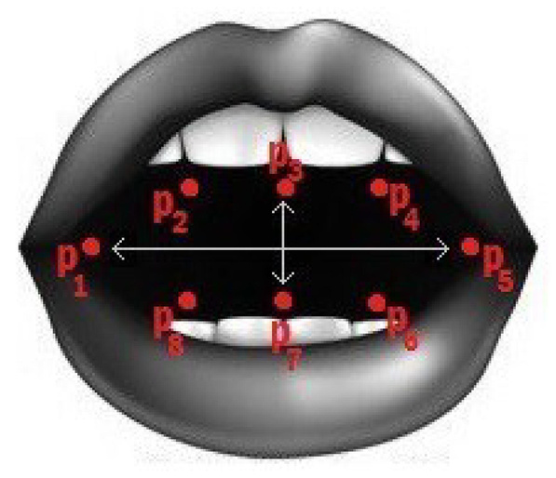
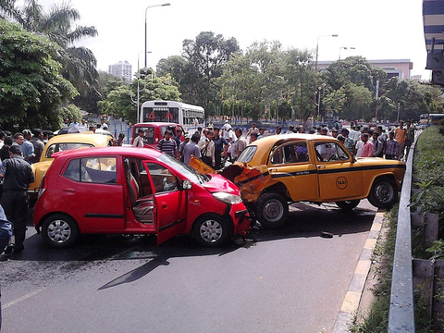
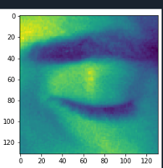
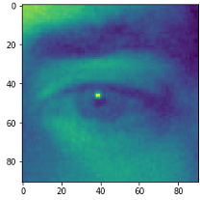
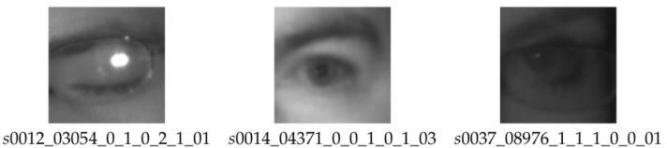
TECHNICAL OVERVIEW
In our drowsiness detection project, we utilize Python, dlib, and OpenCV to create a robust system for real-time monitoring of driver drowsiness.
The project begins by capturing video frames, followed by face detection and precise facial landmark identification, with a particular focus on eye landmarks.
The Eye Aspect Ratio (EAR) is then calculated for each eye using Euclidean distance measurements, serving as an indicator of eye openness.
By continuously comparing EAR values to a predefined threshold, the system detects instances of drowsiness. Additionally we also consider yawning for drowsiness.
When drowsiness is detected, an alert mechanism is triggered to notify the driver, enhancing road safety.
The system can be further customized, fine-tuned, and integrated into various environments, making it a valuable tool for reducing accidents caused by drowsy driving.

Slide 5
Camera
TECHSTACKS AND WORKFLOW
Face Detection
MODEL TRAINING
Eye Tracking
Mouth Tracking
1.DLIB
2.OPENCV
3.NUMPY
4.PYTHON
Calculate EAR
Calculate MOR
DROWSY?
yes
‘Drowsy’
no
Alert
‘Active’

Slide 6
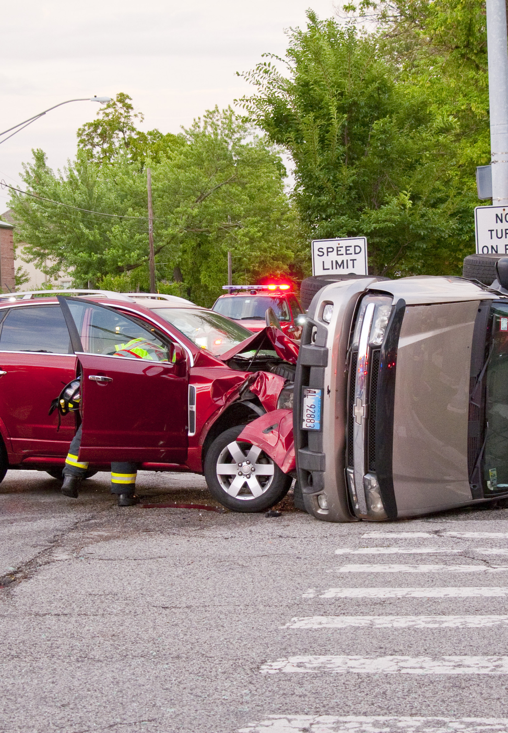
MARKETING PROSPECTS
The market prospects for a drowsiness detection system utilizing the euclidean distance concept with python, dlib, and opencv are highly promising, with potential applications in the
AUTOMOTIVE INDUSTRY,
FLEET MANAGEMENT,
COMMERCIAL VEHICLES,
CONSUMER ELECTRONICS,
RIDE-SHARING SERVICES,
HEALTHCARE, AND
RESEARCH

Slide 7
FUTURE SCOPE
Adaptability to Lighting Conditions and driver behaviour
Providing stimuli like lighting, music to be keep driver alert
Greater customization and personalization according to their age, medical conditions etc.
Data Privacy
Wearable and IOT Devices
Cross Industry Applications like healthcare, workplace safety, and even in entertainment like VR

Slide 8
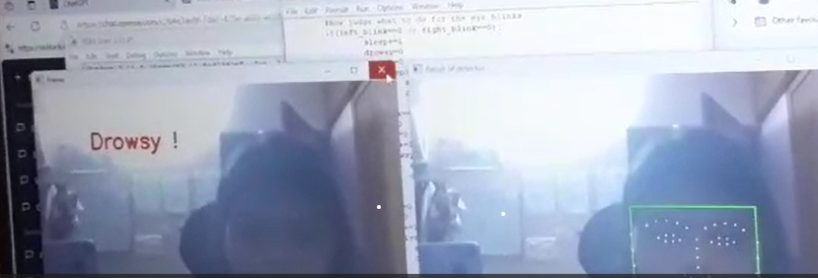
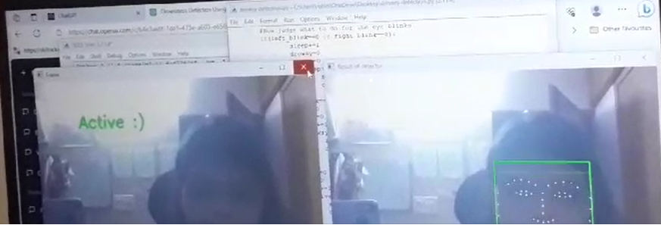
EXECUTION

Slide 9
CONCLUSION
In conclusion, this challenge addresses a critical aspect of road safety by leveraging advanced technologies. The proposed solution, a robust Machine Learning/Deep Learning algorithm, strives to enhance driver monitoring through video analysis. The successful integration of this prototype into vehicles could significantly mitigate the risks associated with driver drowsiness and contribute to a safer driving experience. Ultimately, the project aligns with the broader goal of leveraging innovation to reduce road accidents and improve overall transportation safety.

